Slide 1
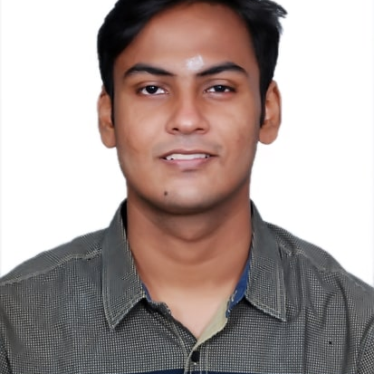
Balaji S S
Analyst/Software Engineer
Bachelor of Engineering
Electronics and Communication: 2018 - 2022
Skills Java 8
Spring Boot
Spring MVC
JPA CRUD
Rabbit MQ
Docker
MERN Stack
ReactJS
MongoDB
Database
No SQL database – MongoDB
Web Technologies
HTML5
CSS3
Javascript
AddOns
Github
Maven
Postman
Additional Details
Excellent Communication Skills
Time management
Mumbai
BALAJI.S-S@CAPGEMINI.COM
+91 7358637156
A4
Software Engineer who has a lot of passion on Web Development, and always happy to implement new projects.
Now I am on the learning part of SQL Database.
Always a team member and ready to learn new technologies to improve myself day by day on this to work on various kinds of projects
Having working Knowledge on Java, REACT, Microservices and Spring Framework.
CROP DEAL Case Study
Completed end to end case study of Crop Deal Application along with JWT authentication, Swagger Junit testing and used REACT for the front end part.
Completed AWS Certified Cloud Practitioner(AWS-CCP)
Certification Courses at Coursera
Introduction to CSS3
Build Your Portfolio Website Using HTML And CSS
Introduction to HTML5

